Slide 1
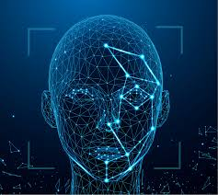
Automated Face Recognition Based Attendance System Using LBPH and Haar Cascade Algorithm

Slide 2
Automated Face Recognition Attendance System
Adu Sumayes Siddiqui
Id:16172103188

Slide 3
Automated Face Recognition Based Attendance System Using LBPH and Haar Cascade Algorithm
Group Members:
Md Abdur Rahman Id:16172103200
Monzurul Islam Bhuiyan Id:16172103201
Md Sajjad Hossain Id:16172103207
Md Abul Kalam Azad Id:16172103384
Supervised by:
Md. Saifur Rahman
Assistant Professor
Bangladesh University Of Business and Technology (BUBT)

Slide 4
Automated Face Recognition Based Attendance System Using LBPH and Haar Cascade Algorithm
Outline:
Introduction
Motivation
Related Work
Problem Background
Projects Objectives
Projects Flow Chart
System Architecture
Face Recognition
Dataset
Face Detection
Result Analysis
Limitation And Future Work
Conclusion
Publication

Slide 5
Automated Face Recognition Based Attendance System Using LBPH and Haar Cascade Algorithm
Introduction:
Biometric system
Face Recognition
Automated System

Slide 6
Automated Face Recognition Attendance System
Md Abul Kalam Azad Id:16172103384

Slide 7
Automated Face Recognition Attendance System
2. Motivation
Due to COVID-19
Completely Automated
Quick And Easy
Less time Consuming

Slide 8
Automated Face Recognition Based Attendance System Using LBPH and Haar Cascade Algorithm
3. Related work
[1] Jadhav, A., Jadhav, A., Ladhe, T., & Yeolekar, K. (2017). Automated attendance system using face recognition. International Research Journal of Engineering and Technology (IRJET), 4(01).
[2] Sutabri, T., Pamungkur, A. K., & Saragih, R. E. (2019). Automatic Attendance System for University Student Using Face Recognition Based on Deep Learning. International Journal of Machine Learning and Computing, 9(5), 668-674.

Slide 9
Automated Face Recognition Based Attendance System Using LBPH and Haar Cascade Algorithm
4. Problem Background.
The present field of face recognition system is dominated by the advance need of the present world. Now people are want the system which will consume less time and do the work smoothly. All the current system are just recognize any face and take attendance but they are not able to give report based on the attendance and some of the system do not maintain any proper database. Face recognition system which are present faces problem while recognizing the face in many situation so that reason those propose systems are not suitable for fulfill the need of the current world.

Slide 10
Automated Face Recognition Attendance System
Monzurul Islam Bhuiyan Id:16172103201

Slide 11
Automated Face Recognition Based Attendance System Using LBPH and Haar Cascade Algorithm
5.Projects Objective:
It will identify any face from any angle.
It will recognize any image from any lighting condition.
It will recognize any image with cap, shades, color or any effects on the image.
It will record real time as attendance.

Slide 12
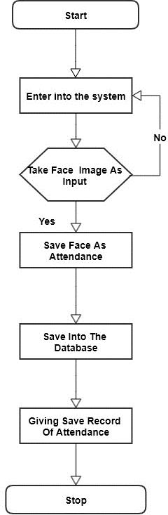
Automated Face Recognition Based Attendance System Using LBPH and Haar Cascade Algorithm
6.Project Flow Chart

Slide 13
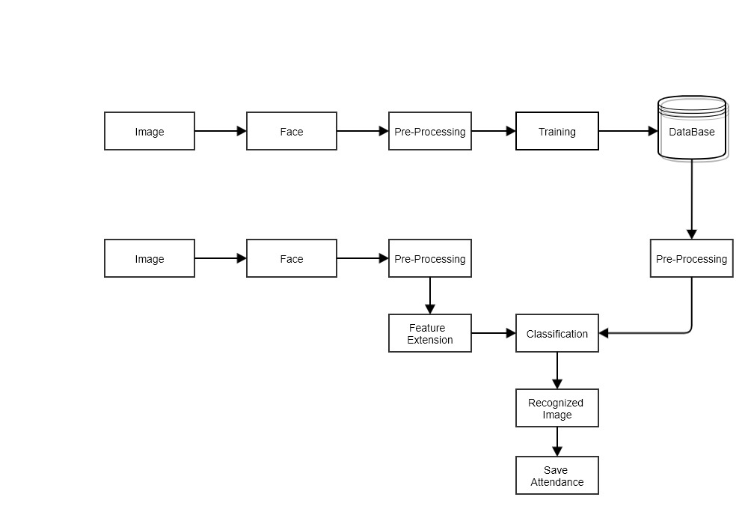
Automated Face Recognition Based Attendance System Using LBPH and Haar Cascade Algorithm
7.System Architecture

Slide 14
Automated Face Recognition Attendance System
Md Sajjad Hossin
Id:16172103207

Slide 15
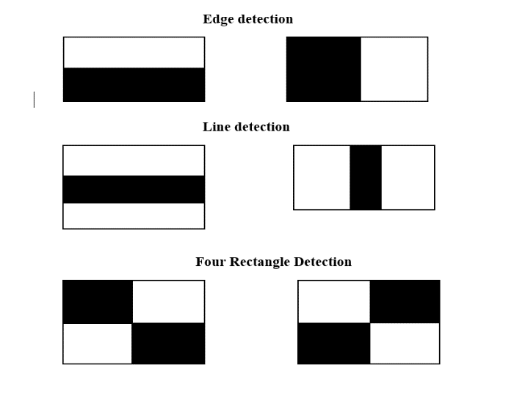
Automated Face Recognition Based Attendance System Using LBPH and Haar Cascade Algorithm
8.Face Recognition

Slide 16
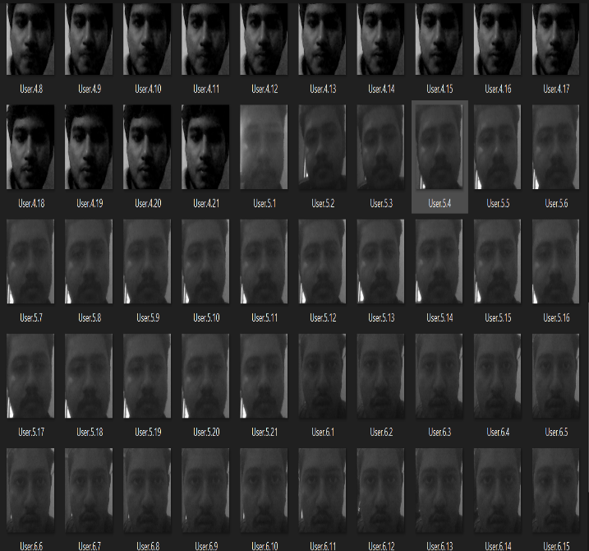
Automated Face Recognition Based Attendance System Using LBPH and Haar Cascade Algorithm
9.Data Set

Slide 17
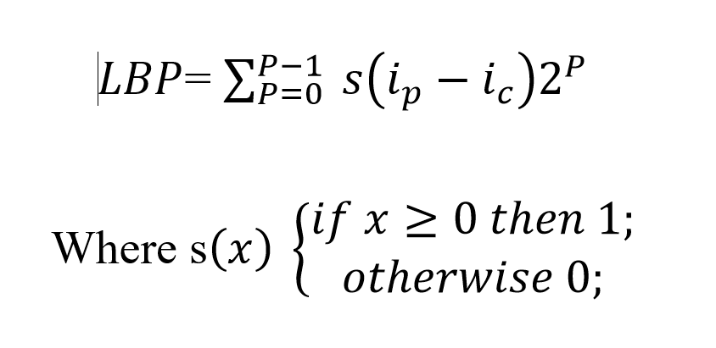
Automated Face Recognition Based Attendance System Using LBPH and Haar Cascade Algorithm
10.Face
Detection

Slide 18
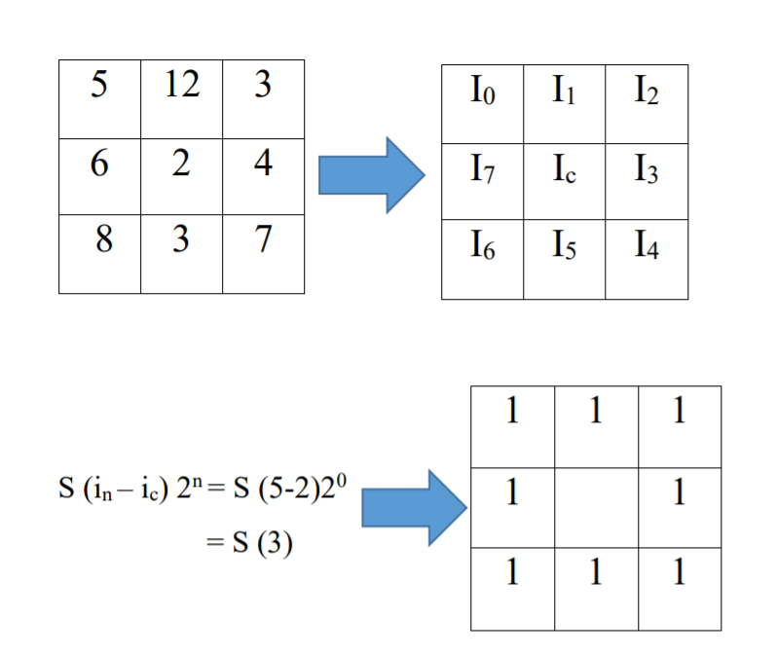
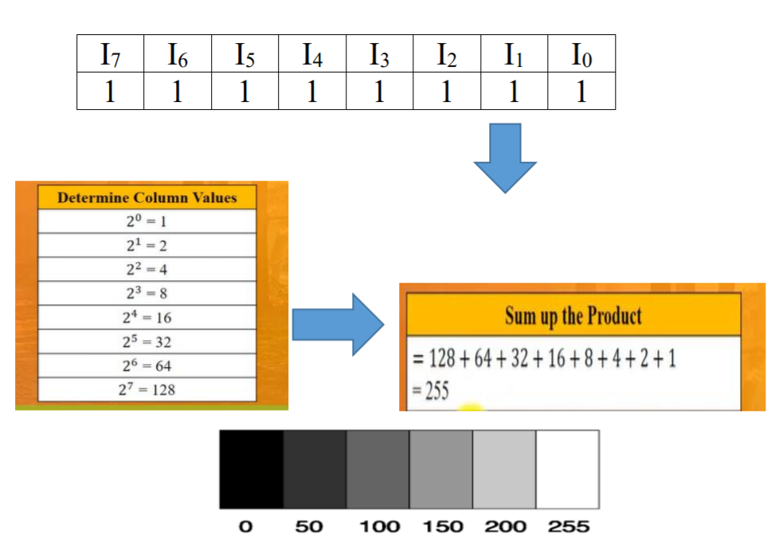

Slide 19
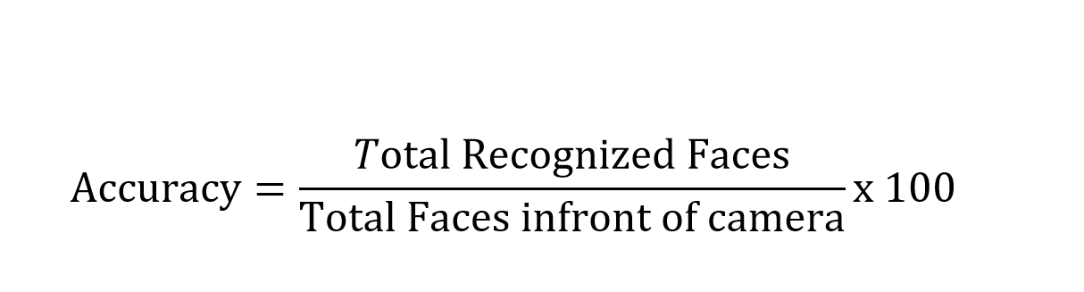
Automated Face Recognition Based Attendance System Using LBPH and Haar Cascade Algorithm
11.Result
Analysis

Slide 20
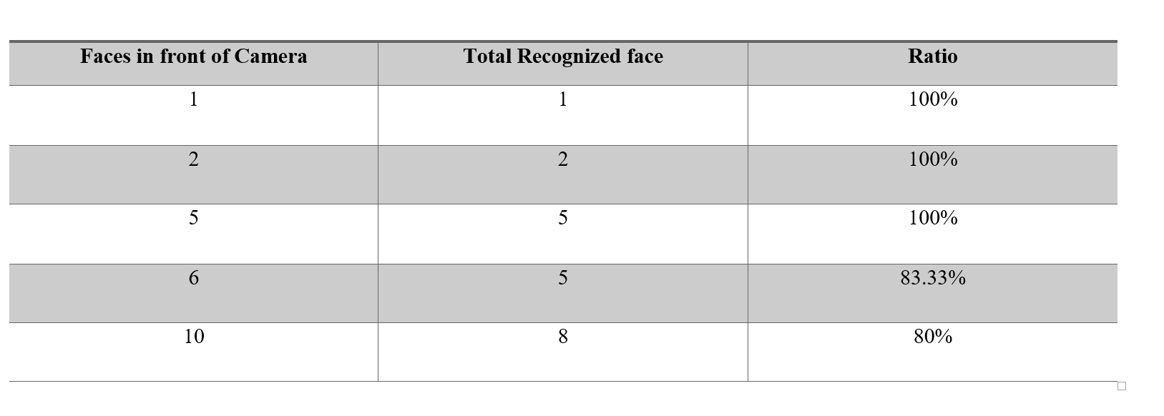
Automated Face Recognition Based Attendance System Using LBPH and Haar Cascade Algorithm

Slide 21
Automated Face Recognition Attendance System
Md Abdur Rahman Id:16172103200

Slide 22
Automated Face Recognition Based Attendance System Using LBPH and Haar Cascade Algorithm
12.Limitation And Future Work:
The project is now working fine but in future we will try to work inside the face recognition algorithm more and try to increase the accuracy. We will modify the GUI (Graphical User Interface) to look it more attractive. We will also try to increase some features which will help the user to manage the system easily.

Slide 23
Automated Face Recognition Based Attendance System Using LBPH and Haar Cascade Algorithm
13.Conclusion:
In this project, we present a work that uses faces, that is hardly used in any other attendance taking method. The project is tested in a busy place there it works perfectly. Although the project almost fails in the situation if the faces are out of focus from the camera. The project accuracy can be improved if the camera regulation get the image accurately more accurately. In recent pandemic situation COVID-19 is spreading all over the world. As we know the virus is spreading through physical contact most of the institute are using finger print as taking attendance and authentication were physical touch is must and the chances of spreading COVID-19 is more. Therefor in this situation our project work will help to take attendance without any physical connection and we hope it will help to reduce the attack of the deadly virus.

Slide 24
Automated Face Recognition Based Attendance System Using LBPH and Haar Cascade Algorithm
14.Publication:
Conference:
2021 ICCIS: 3rd International Conference on Computer and Information Sciences
Sakaka/ Aljouf, Saudi Arabia, October 19-21, 2021

Slide 25
Thank You

Slide 26

Automated Face Recognition Based Attendance System Using LBPH and Haar Cascade Algorithm

